Slide 1
Characterization of mutational processes affecting metastatic transformation in melanoma and the impact on therapy effectiveness
Doan Trang Laura Vo Ngoc
07 September, 2018

Slide 2
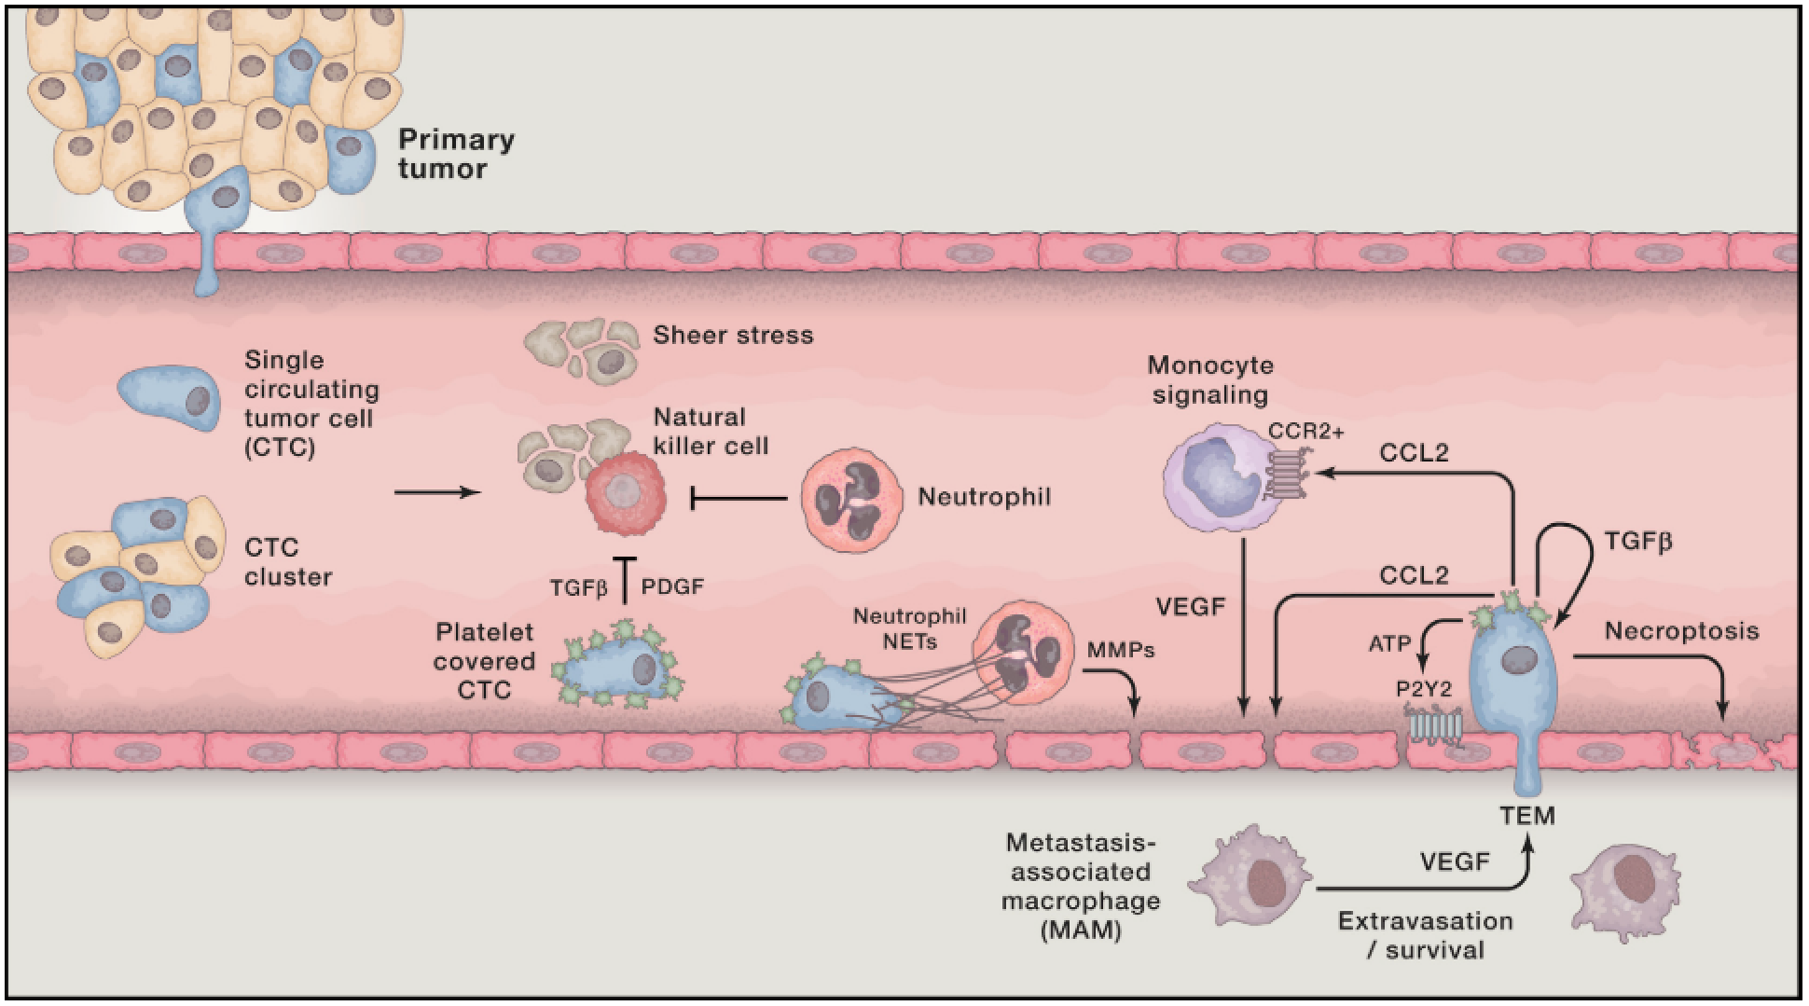
Metastasis
SEEDING
IMMUNE RECRUITMENT
COLONIZATION
(Lambert, Cell, 2017)
Notes:
Leading cause of death
Seeding into surrounding tissue then bloodstream
Immune recruitment – to protect from other immune cells and build ideal environment
Invasion and colonization of distant sites
While certain processes are understood, hard to predict

Slide 3
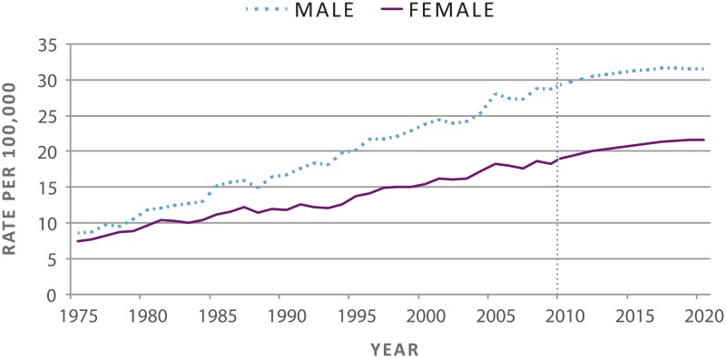
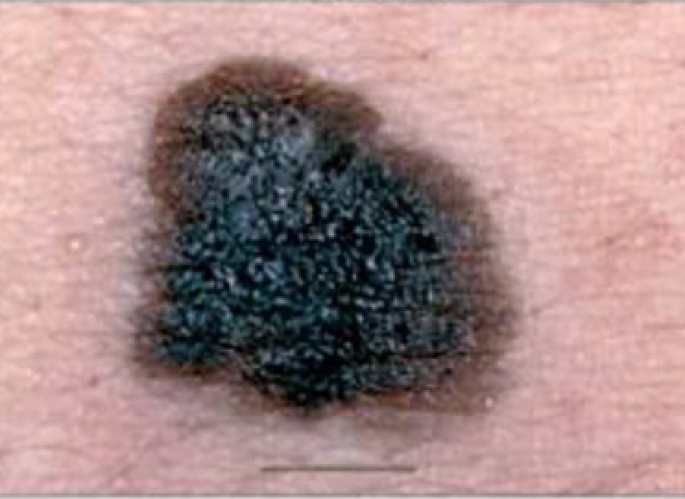
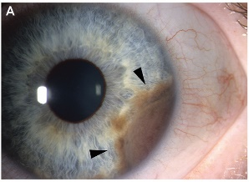
Melanoma
Rising incidence
5-year survival
Primary: 99%
Metastatic: 49%
Subtypes
Acral, mucosal, uveal, cutaneous
Pathways involved in:
Cell growth
Survival
Proliferation
Cutaneous
Uveal
(US Department of Health and Human Services, 2014 Arrangoiz et al., J. Cancer Treat. Res., 2016)
Notes:
Melanoma – transformation of pigment-producing melanocytes
Subtypes – based on site
Results from mutations in pathways

Slide 4
Melanoma
Rising incidence
5-year survival
Primary: 99%
Metastatic: 49%
Subtypes
Acral, mucosal, uveal, cutaneous
Pathways involved in:
Cell growth
Survival
Proliferation
Therapies
Surgery
Chemotherapy
Radiotherapy
Targeted therapies
Immune-checkpoint therapies

Slide 5
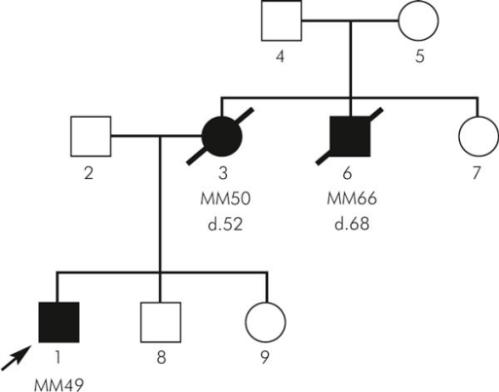

Melanoma risk factors
UV light exposure
Family history
Lighter skin tone
Aging
(Dębniak, Hered. Cancer Clin. Pract., 2004)
Specific mutations
Notes:
Risk factors induce mutations in genome
Mutations are specific and recognizable
risk factors for melanoma mainly uv, etc

Slide 6
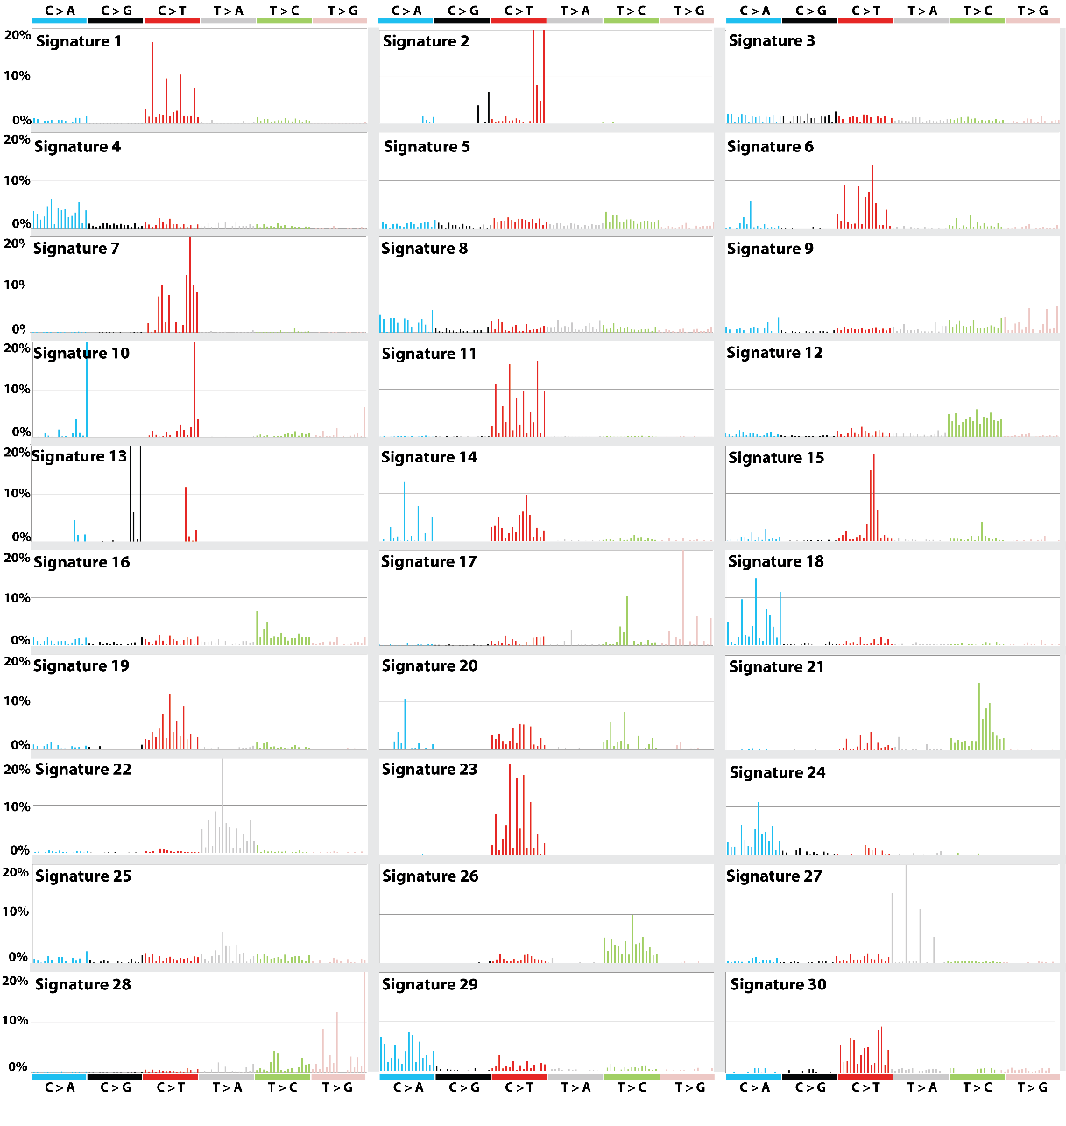
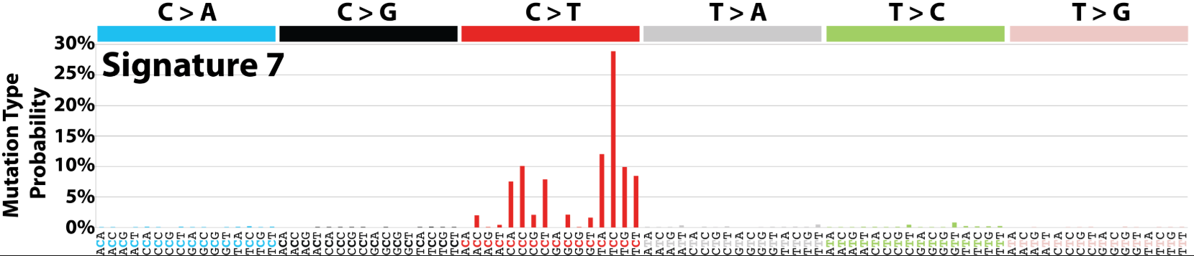
Mutational signatures
Context-specific somatic mutations
Two adjacent bases are important
Example: T[C]C > T[T]C
Associated to risk factors
Identified by non-negative matrix factorization (NMF)
COSMIC https://cancer.sanger.ac.uk/cosmic/signatures
UV LIGHT EXPOSURE
(Alexandrov et al., Nature, 2013; Forbes et al., Nucleic Acid Res.,2018)
Notes:
Sigs – specific patterns of mutations in genome
– 30 validated signatures
– each associated to risk factors
NMF – identified using NMF or similar methods
– identifies patterns in genomes and how prevalent they are

Slide 7
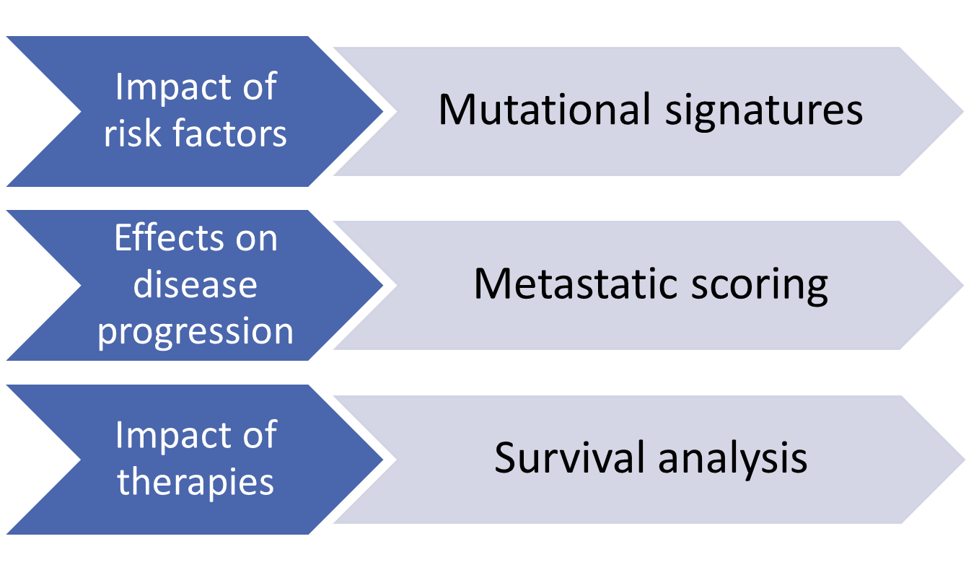
Aims & methods overview

Slide 8



Methods
The Cancer Genome Atlas (TCGA)
Whole exome sequencing
Clinical data
Gene expression data
Two cohorts
Skin cutaneous melanoma (n=487)
Uveal melanoma (n=80)
Validation dataset – International Cancer Genome Consortium (ICGC)
Whole genome sequencing
Two cohorts
Australian melanoma (n=107)
Brazilian skin adenocarcinoma (n=100)

Slide 9
Methods
The Cancer Genome Atlas (TCGA)
Whole exome sequencing
Clinical data
Gene expression data
Two cohorts
Skin cutaneous melanoma (SKCM)
Uveal melanoma (UVM)
Validation dataset – International Cancer Genome Consortium (ICGC)
Whole genome sequencing
Two cohorts
Australian melanoma (n=107)
Brazilian skin adenocarcinoma (n=100)

Slide 10
Results

Slide 11
Mutational signatures
primary
metastatic
Notes:
SKCM – sigs contributing >1%
UVM – sigs contributing > 2.5%
Different landscapes

Slide 12
Top 5 contributors
Sample | Signatures | Etiology
SKCM | S7 | UV light exposure
 | S1 | Aging
 | S11 | Alkylating agents
 | S23 | Unknown; strong transcriptional strand bias
 | S6 | Defective DNA mismatch repair
UVM | S1 | Aging
 | S22 | Aristolochic acid
 | S15 | Defective DNA mismatch repair
 | S3 | DNA double-strand break repair failure
 | S6 | Defective DNA mismatch repair
Notes:
Including a number of signatures associated with defective repair pathways
Next, want to see impact on metastatic progression

Slide 13
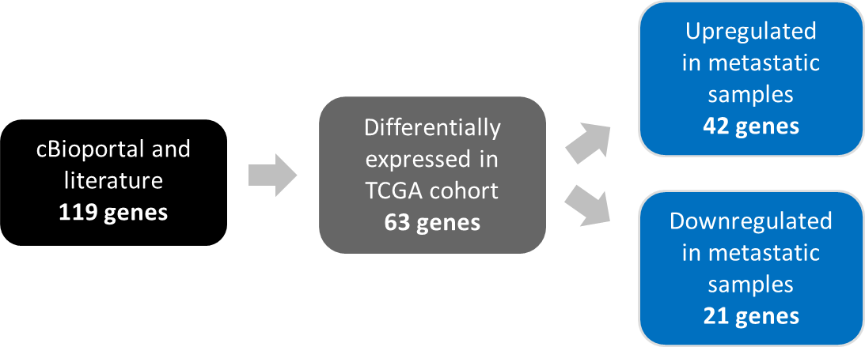
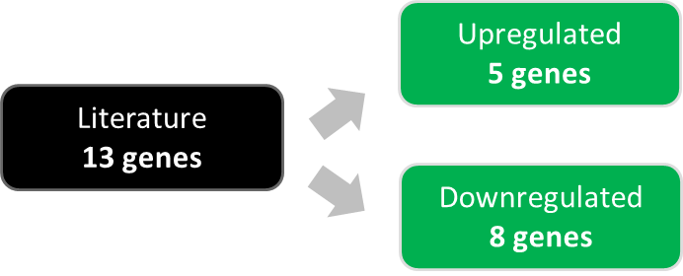
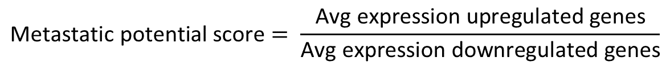
Metastatic scoring
CDK1, DNA2, HMGA2,
certain MMPs
…
SKCM
CDH1, CDK2, GALK1,
certain MMPs
…
CDH1, ECM1, HTR2B, PRAME, RAB31
UVM
EIF1B, FXR1, ID2, LMCD1, LTA4H
…
$$\text{Metastatic} \text{potential} \text{score}= \frac{\text{Avg} \text{expression} \text{upregulated} \text{genes}}{\text{Avg} \text{expression} \text{downregulated} \text{genes}}$$
Notes:
Score of metastatic potential
Based on expression of metastatic marker genes
Different approaches based on data availability: UVM has no metastatic samples
Once determined genelist separated into upreg and downreg
Score defined using a ratio of this

Slide 14
Primary SKCM | Metastatic SKCM | Primary UVM
METASTATIC SCORING
Notes:
Explain cancer stage – more advanced the cancer is, the higher the stage
Metscore increases with stage in primary
Decreases in metastatic, likely due to less risk of metastasis following a metastatic event

Slide 15
Metastatic score correlates (primary SKCM)
Signature 1 (aging)
Correlation coefficient = 0.16
p = 0.10
Signature prevalence alone
Signature 7 (UV)
Correlation coefficient = 0.14
p = 0.17
Notes:
To see impact of risk factors on progression, correlated sigs to score

Slide 16
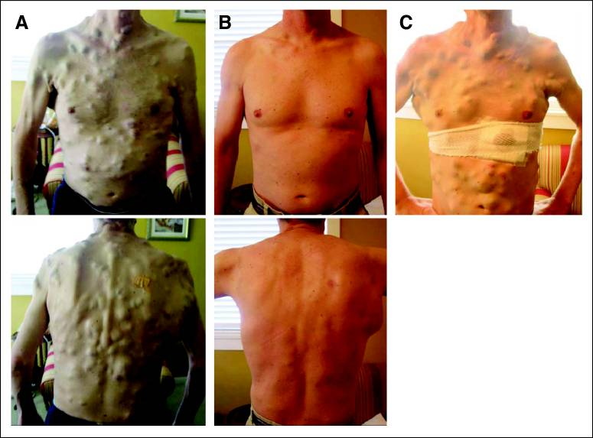
BRAF: driver of melanoma
Before treatment | 15 weeks | 23 weeks
BRAF mutated in 40-60% patients
Inhibitors used for targeted therapies
Eventual resistance
(Wagle et al., J. Clin. Onco., 2011)
Notes:
BRAF is gene mutated in 40-60% patients
Targeted with inhibitors as a treatment
Unfortunately lead to resistance

Slide 17
Metastatic score correlates (primary SKCM)
Signature 1 (aging)
Correlation coefficient = 0.43
p = 0.03
Signature prevalence alone
Signature prevalence in genetic context (BRAF WT)
Signature 7 (UV)
Correlation coefficient = 0.46
p = 0.02
Notes:
See if carcinogenic risk factors impact depends on genetic context

Slide 18
Metastatic score correlates (primary SKCM)
Signature 1 (aging)
Correlation coefficient = 0.41
p = 0.82
Signature prevalence alone
Signature prevalence in genetic context (BRAF WT)
Signature prevalence in genetic context (BRAF mutant)
Signature 7 (UV)
Correlation coefficient = 0.11
p = 0.57
Notes:
In absence of mutation, risk factor drive progression

Slide 19
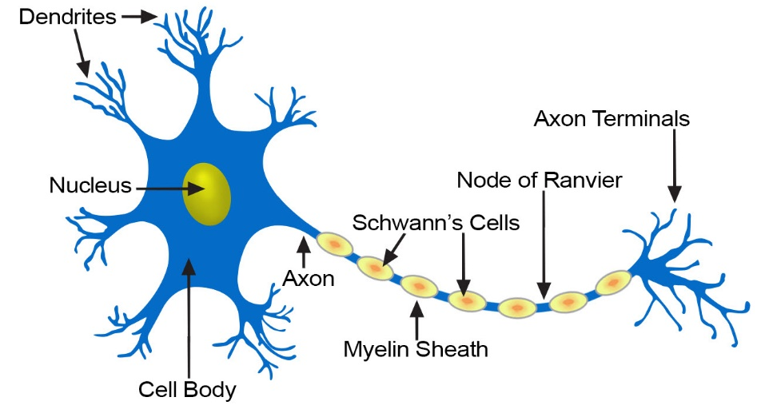
Schwann cells
(US National Institutes of Health: National Cancer Institute, 2018)
Notes:
Schwann cells – produce myelin sheath around the axons of neurons
Tend to infiltrate vascularized tissue such as epithelium
Shown to be involved with metastatic dissemination
+ refs

Slide 20
Metastatic score correlates (all samples)
Primary SKCM (n=80)
Metastatic SKCM (n=300)
Signature prevalence alone
Signature prevalence in genetic context (BRAF WT)
Signature prevalence in genetic context (BRAF mutant)
Schwann cell marker genes expression
Primary UVM (n=71)
Primary SKCM
Correlation coefficient = 0.26
p = 0.05
Metastatic SKCM
Correlation coefficient = 0.13
p = 0.002
Primary UVM
Correlation coefficient = 0.19
p = 0.04
Notes:
Correlated expression of Schwann marker genes to score
Slight positive corr: confirms that the score is good proxy for metast progression
Used RNASeq data from TCGA to analyze expression

Slide 21
Metastatic potential cutoff
Low metastatic potential
High metastatic potential
Primary SKCM
Metastatic SKCM
Primary UVM
Notes:
Where do we draw cutoff in low/high potential, based on distribution
Then lead to next slide

Slide 22
Survival by metastatic potential
UVM
SKCM

Slide 23
Survival
Primary SKCM
Therapies
Risk factors (mutational signatures)
Notes:
Why we look at survival and sigs
Motivate why we looked at signatures as well
- Risk factors may sensitize cells to therapies differently and thus impact outcome
- Signature -> earlier metast -> diff response to treatment -> survival

Slide 24
Multivariate survival models
+ risk of death
Improved survival
Not statistically significant
Primary SKCM (n=27)
Brazilian cohort (n=95)
Metastatic SKCM (n=21)
Risk of death
Australian cohort (n=94)
Notes:
Shows impact of each of these parameter on risk of death
Brazilian: again, S6 impacts survival when accounting for therapies

Slide 25
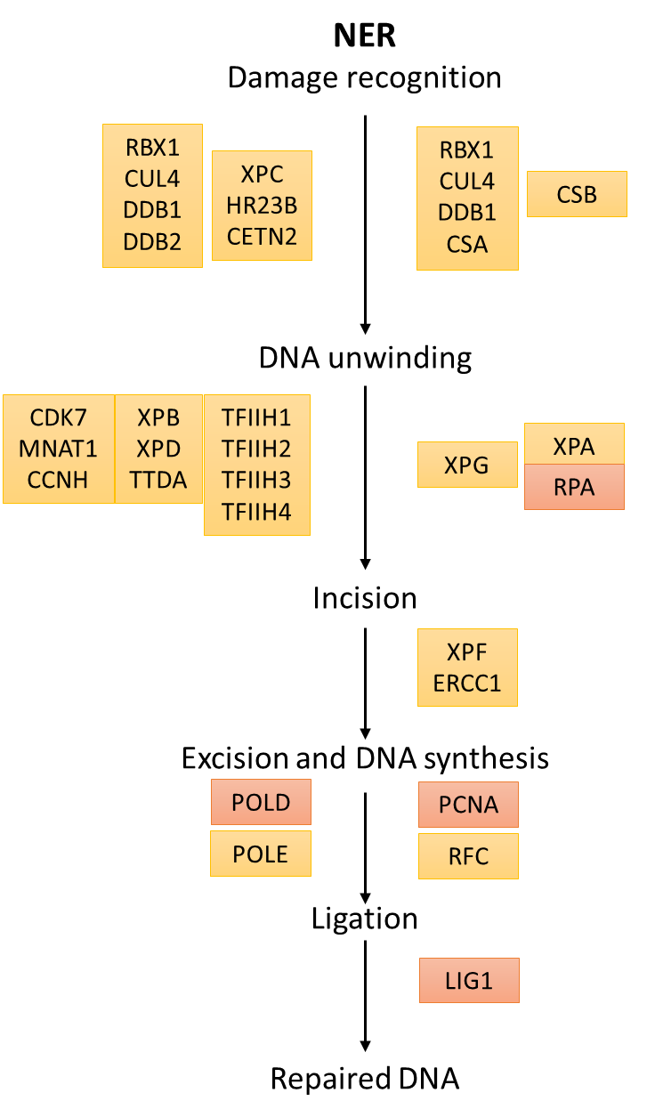
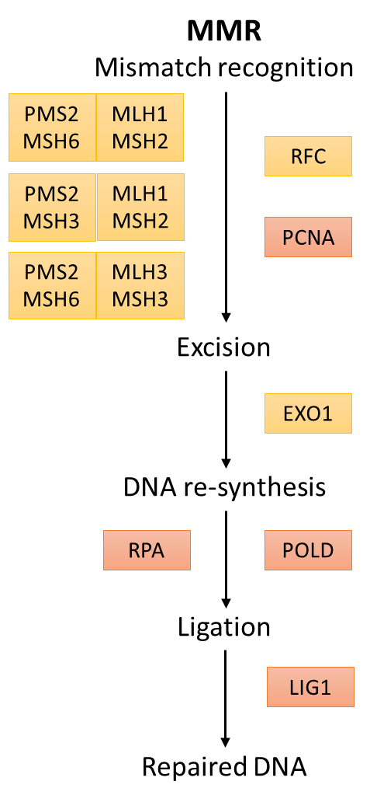
NER / MMR
Nucleotide excision repair (NER) | Mismatch repair (MMR) | Others with transcriptional strand bias
S4 | S6 | S2
S7 | S15 | S5
S11 | S20 | S12
S22 | S26 | S23
S24 |  | S27
S25
Genes in pathways (POLD, LIG1, RFC, …) correlate with metastatic potential
Notes:
Further argument/power for involvement of ner/mmr pathways in metast progression

Slide 26
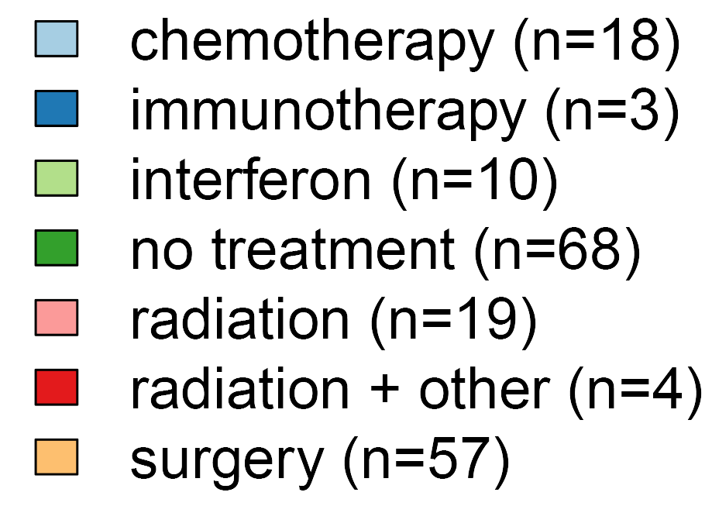
Survival model in combined cohort
BETTER OUTCOME

Slide 27
Survival model in combined cohort
Without treatment
+ risk of death
Improved survival
Not statistically significant
Risk of death
Notes:
NER –associated sigs, cohort, stage, age

Slide 28
Survival model in combined cohort
With treatment
+ risk of death
Improved survival
Not statistically significant
Risk of death
Notes:
NER –associated sigs no longer impact
S6 (MMR) again impacts

Slide 29
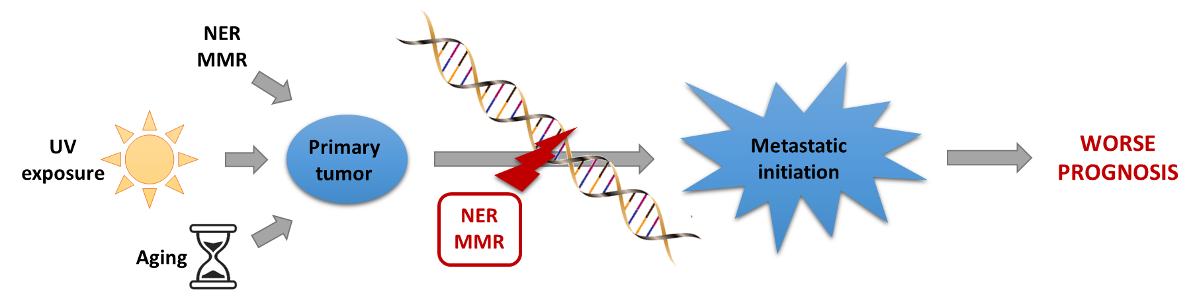
Conclusion
UV light + BRAF WT
Repair pathways and UV exposure in absence of BRAF mutation drive metastatic progression.
Notes:
Risk factors result in mutations leading to disease presentation
But repair pathways and UV exposure in absence of BRAF mutation drive metastatic progression
Leading to worse prognosis

Slide 30
Some limitations
TCGA limitations
Small sample size
Lack of samples from same patient
Non-uniform and missing clinical annotations
Whole exome sequencing
ICGC lack of expression data
TCGA and ICGC data differences (WES vs. WGS)
Impact signature profiles
Notes:
Explain what matched samples mean
Or just say lack of prim and metast sample from the same samples
Explain why it matters that we’re not capturing whole genome (WES) → 1.5% of genome

Slide 31
Future research
Replication in larger cohorts
Better clinical data annotation
Uniformalized data acquisition methods
More complete survival annotation
Metastatic scoring
More specific marker genes (SKCM)
Chromosomal instability
Comparison with new mutational signatures (Alexandrov et al., 2018)
Comparison with cancer in other tissues
(Alexandrov et al., Nature, 2013)
(Alexandrov et al., bioRxiv, 2018)

Slide 32
Thank you for listening!
Any Questions?

Slide 33
References
Alexandrov LB, Nik-Zainal S, Wedge DC, et al. Signatures of mutational processes in human cancer. Nature. 2013;500(7463):415-421.
Arrangoiz R. Melanoma Review: Epidemiology, Risk Factors, Diagnosis and Staging. J Cancer Treat Res. 2016;4(1):1.
Dębniak, T., 2004. Familial Malignant Melanoma - Overview. Hered. Cancer Clin. Pract. 2, 123. https://doi.org/10.1186/1897-4287-2-3-123
Forbes, S.A., Bindal, N., Bamford, S., Cole, C., Kok, C.Y., Beare, D., Jia, M., Shepherd, R., Leung, K., Menzies, A., Teague, J.W., Campbell, P.J., Stratton, M.R., Futreal, P.A., 2011. COSMIC: mining complete cancer genomes in the Catalogue of Somatic Mutations in Cancer. Nucleic Acids Res. 39, D945–D950. https://doi.org/10.1093/nar/gkq929
Lambert AW, Pattabiraman DR, Weinberg RA. Emerging Biological Principles of Metastasis. Cell. 2017;168(4):670-691.
Lo, J.A., Fisher, D.E., 2014. The melanoma revolution: From UV carcinogenesis to a new era in therapeutics. Science (80-. ). 346, 945–949. https://doi.org/10.1126/science.1253735
Sandru A, Voinea S, Panaitescu E, Blidaru A. Survival rates of patients with metastatic malignant melanoma. J Med Life. 2014;7(4):572-576.
US Department of Health and Human Services, 2014. Figure 3, Age-Adjusted Melanoma Incidence Rates, Actual and Projected, by Sex, 1975–2020, in: The Surgeon General’s Call to Action to Prevent Skin Cancer. Office of the Surgeon General (US), Washington (DC).
US National Institutes of Health National Cancer Institute, 2018. SEER Training Modules, Nerve Tissue [WWW Document]. URL https://training.seer.cancer.gov/anatomy/nervous/tissue.html (accessed 02.09.18).
Wagle, N., Emery, C., Berger, M.F., Davis, M.J., Sawyer, A., Pochanard, P., Kehoe, S.M., Johannessen, C.M., MacConaill, L.E., Hahn, W.C., Meyerson, M., Garraway, L.A., 2011. Dissecting Therapeutic Resistance to RAF Inhibition in Melanoma by Tumor Genomic Profiling. J. Clin. Oncol. 29, 3085–3096. https://doi.org/10.1200/JCO.2010.33.2312

Slide 34
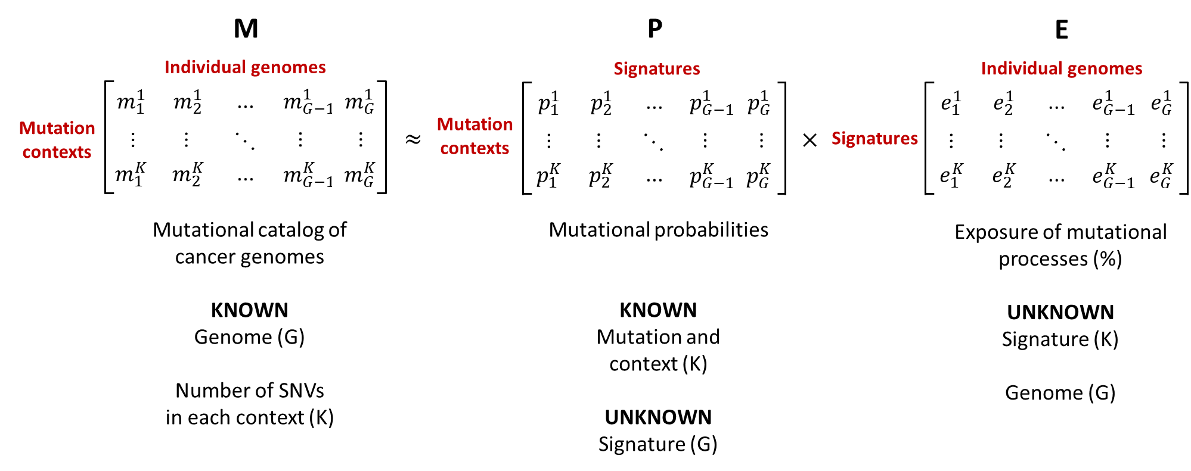
Non-negative matrix factorization (NMF)

Slide 35
ICGC mutational signatures
Brazilian cohort
Australian cohort

